Slide 1
CSE3501
Information Security Analysis and Audit
05/12/21

Slide 2
Web Based Graphical Password Authentication System
Submitted by
Nandini Sachan 19BEC1216
Khushi Akhoury 19BEC1443
Samiul Haque 19BEC1389
Under the guidance
Dr. P. Vijayakumar
School of Electronics Engineering
VIT University, Chennai

Slide 3
OVERVIEW
Objective
Abstract
Introduction
Related Work
Traditional Graphical password authentication system
Limitations
Proposed Graphical password authentication system algorithm & workflow
Algorithm
Flowchart
Components & Software unit
Simulation snapshots
Advantages
Conclusion
References

Slide 4
OBJECTIVE
In this report, the improvement of password identification authentication system with the assistance of pictures is planned. Password identification authentication is critical to shield the privacy and information of users on varied servers. Passwords that are straightforward to crack are a lot of liable to hackers who will exploit the user data to great extents. This paper chiefly focuses on the idea of Recognition based mostly graphical password identification authentication system.

Slide 5
ABSTRACT
Password authentication is necessary to protect the privacy and data of users on various servers. Passwords that are easy to crack are more prone to hackers who can exploit the user information to great extents. This project focuses on the concept of Recognition based authentication system. This system is best alternative for text password which are easy to forget and easy to crack and hence more vulnerable. Traditional techniques like recall-based systems also have disadvantages like Spyware Attack, Shoulder Surfing Attack and Physical Attack. In order to overcome the above limitations, recognition-based algorithm is proposed. Exceptional ability of humans to recognize the images previously seen made the recognition-based algorithms more popular. In this project Recognition Based technique is clubbed with new technologies like web applications and E-mail.

Slide 6
INTRODUCTION
Initially web authentication was done on the basis of text password. But as time goes on this system finds many disadvantages.
This was not trusted as it always had threat of getting hacked.
The graphical password authentication system proposed here, creates great impact.
This system overtakes all the disadvantages of the old password authentication system.
Recognition-based system is nothing but selecting few images from a set of different images and remembering the sequence.
It helps to enhance the graphical password authentication system. It also creates best system for user to use and memorable system.

Slide 7
RELATED WORK
AE Dirik, et.al, introduced about Pass Point system in a research paper titled as, Modelling user choice in the Pass Points Graphical Password Scheme. In this system, users can create many points click sequence on a background image. Sequence of clicks is generated to derive the password. Main disadvantage here is that password cannot be reset once forgotten.
Arti Bhanushali, et.al, introduced about Deja Vu algorithm in a research paper titled as, Comparison of Graphical Password Authentication Techniques. In this technique, user is provided with a random set of images. Which is generated using Hash visualization technique. During registration of a new user, a seed value gets generated for that user which gets stored at a trusted server. Using this seed value one random mathematical formula is generated which is applied on each pixel value to get a new image. Disadvantages are the seed values generated are stored on a trusted server. If the server fails, seed values get corrupted and also it is time consuming.

Slide 8
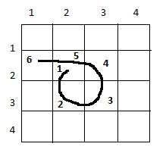
TRADITIONAL GRAPHICAL AUTHENTICATION SYSTEM
Recall Based Graphical Password Authentication System - In recall-based techniques, a user is asked to reproduce something that he or she created or selected earlier during the registration stage. Here we will focus on recognition-based systems as they are likely to be associated with lower cognitive demand and can exploit the well-documented advantage of recognition over either pure or cued-recall.

Slide 9
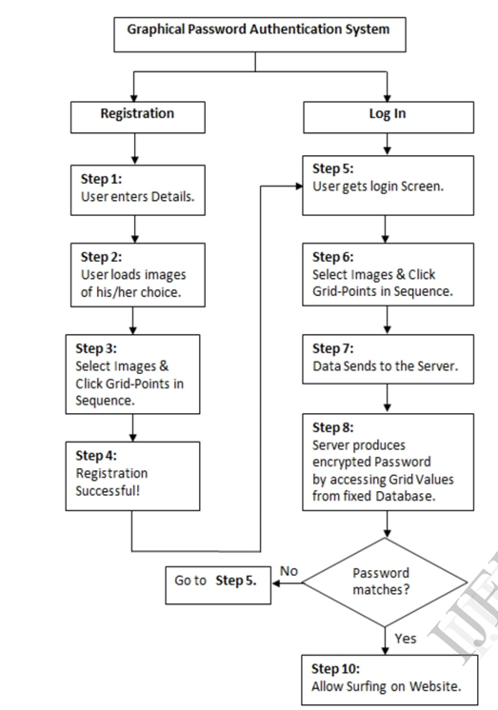
TRADITIONAL GRAPHICAL AUTHENTICATION SYSTEM - BLOCK DIAGRAM

Slide 10
TRADITIONAL GRAPHICAL PASSWORD AUTHENTICATION SYSTEM - LIMITATIONS
Recall based Graphical Password Authentication has a major limitation of easily being prone to the Graphical Password Attacks such as:
Spyware Attack: This attack uses a small application installed (accidentally or secretly) on a user’s computer to record sensitive data during mouse movement or key press.
Social Engineering Attack (Description Attack): This type of attack happens when a non-authorized personal manages to impersonate authorized employees and access confidential information (i.e.) passwords and graphical codes.
Physical Attack: this type of attack happens when a user can access directly to the data in the server.
Shoulder Surfing: shoulder surfing is watching over people’s shoulders as they process information.

Slide 11




TRADITIONAL GRAPHICAL PASSWORD AUTHENTICATION SYSTEM - LIMITATIONS

Slide 12
PROPOSED RECOGNITION BASED SYSTEM - ALGORITHM
Step 1 Start
Step 2 home-->Register-->Enter username-->Enter email
Step 3 print random images to prevent attack
images = random.sample()
print(images)
Step 4 select images as password
Step 5 login_info = loginInfo(user = user, fails = 0)
login_info.save()
messages.success(‘Account created!’)

Slide 13
PROPOSED RECOGNITION BASED SYSTEM - ALGORITHM
return to home
except Exception:
messages.warning(‘Error!’)
Step 6 Redirect to login
Step 7 Login-->Enter username-->Enter password
Step 8 If didSuccess == true
User.logininfo.fails = 0
messages.success(‘Login Successful!’)

Slide 14
PROPOSED RECOGNITION BASED SYSTEM - ALGORITHM
Else
User.logininfo.fails += 1
messages.warning(‘incorrect credentials!’)
Print(‘failed attempts: ’.format(user.username, user.logininfo.fails))
Redirect to login
Step 9 if user.logininfo.fails >= TBA
print(‘isBlocked: ’ .format(userlogininfo, TBA))
Step 10 send email only if user.logininfo.login_link is None

Slide 15
PROPOSED RECOGNITION BASED SYSTEM - ALGORITHM
if user.logininfo.login_link is None
link = str(uuid.uuid4())
user.logininfo.login_link = link
user.logininfo.save()
Step 11 email = EmailMessage(subject = ‘link to login to you account.’,
body = ‘’’ --- someone tried to brute force your account ---
link: http://{}8000/login/{} --- ‘’’
.format(ALLOWED_HOST[-1], link), from_email = EMAIL_HOST_USER, to = [user.email])

Slide 16
PROPOSED RECOGNITION BASED SYSTEM - ALGORITHM
Email.send()
Step 12 send reset link every time user requests
Step 13 repeat 10
Step 14 email = EmailMessage(subject = ‘link to reset your password.’,
body = ‘’’ --- you have requested to reset your password ---
link: http://{}8000/login/{} --- ‘’’
.format(ALLOWED_HOST[-1], link), from_email = EMAIL_HOST_USER, to = [user.email])
Email.send()

Slide 17
PROPOSED RECOGNITION BASED SYSTEM - ALGORITHM
Step 15 if logout(request)
messages.warning(‘you’ve been logged out!’)
Step 16 redirect to home
Step 17 end

Slide 18
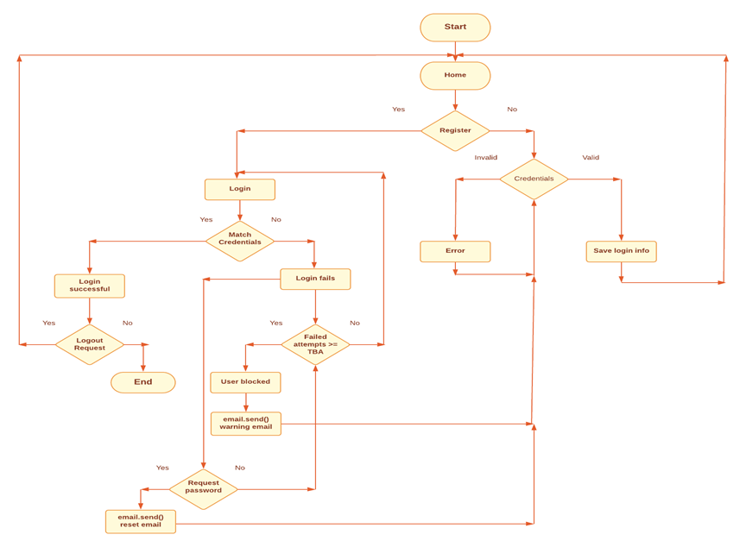
PROPOSED RECOGNITION BASED SYSTEM - FLOWCHART

Slide 19
PROPOSED RECOGNITION BASED SYSTEM - COMPONENTS
1. admin.py : We have created this file for accessing the database as the admin. In this file, we have imported details from models file which comprises of input credentials of the user and store it together at a place.
2. apps.py : This file is created to include any application configuration for the app. Using this, we configure some of the attributes of the application.
3. models.py : We have made this file so as to check whether the credentials entered by the user for the first time when he/she created an account of its own is unique or not and have entered the command for comparing and checking of cases such as login fail, reset password, failure in entering the wrong password and checking whether the credentials entered initially don’t cascade with the already existing credentials.

Slide 20
PROPOSED RECOGNITION BASED SYSTEM - COMPONENTS
4. test.py : This file comprises of testcases for this project. Here there will be various situational cases if the program faces any malfunction.
5. urls.py : We have created this file so as to create urls for homepage, register page, login page, logout page, login from uid, reset view and reset from uid. It comprises of url pattern for each mentioned above along with their name which will be displayed on webpage when using it.
6. views.py : This file comprises of a total layout of the project. In this file, there are various classes such as getting password images, updating login information, sending reset password mail to user, sending login link mail to user and all the webpages.

Slide 21
PROPOSED RECOGNITION BASED SYSTEM - COMPONENTS
7. manage.py : This file comprises of commands for winding up the total project in one unit and while executing it, this file makes all the files linked up together into one framework.
8. HTML files: There are various HTML files which frame the webpage and add colour and look to this project.

Slide 22





PROPOSED RECOGNITION BASED SYSTEM - SOFTWARE UNIT & PACKAGES
Visual Studio Code - Main code and local server
Django - python framework
HTML & CSS - Structure & styling of the web page
Gmail API - Password Reset
SQLite - Creating Database

Slide 23
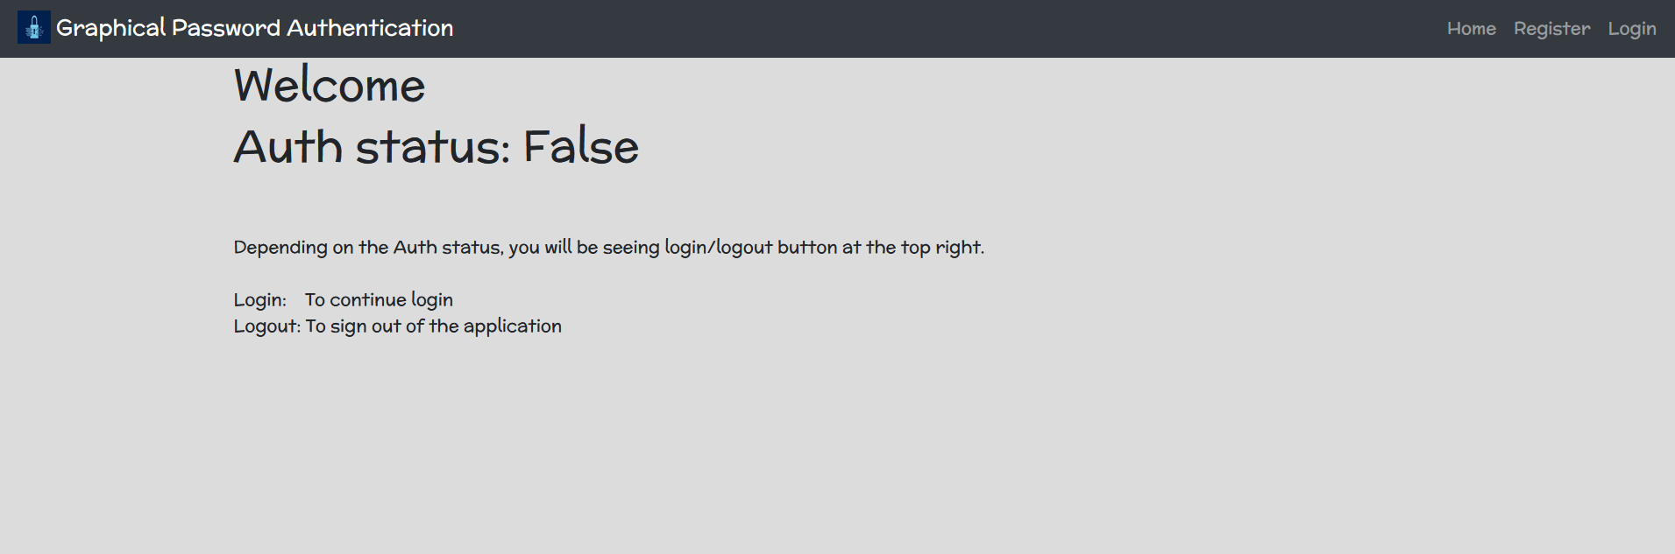
SIMULATION SNAPSHOTS
Shows authorization status of the user

Slide 24
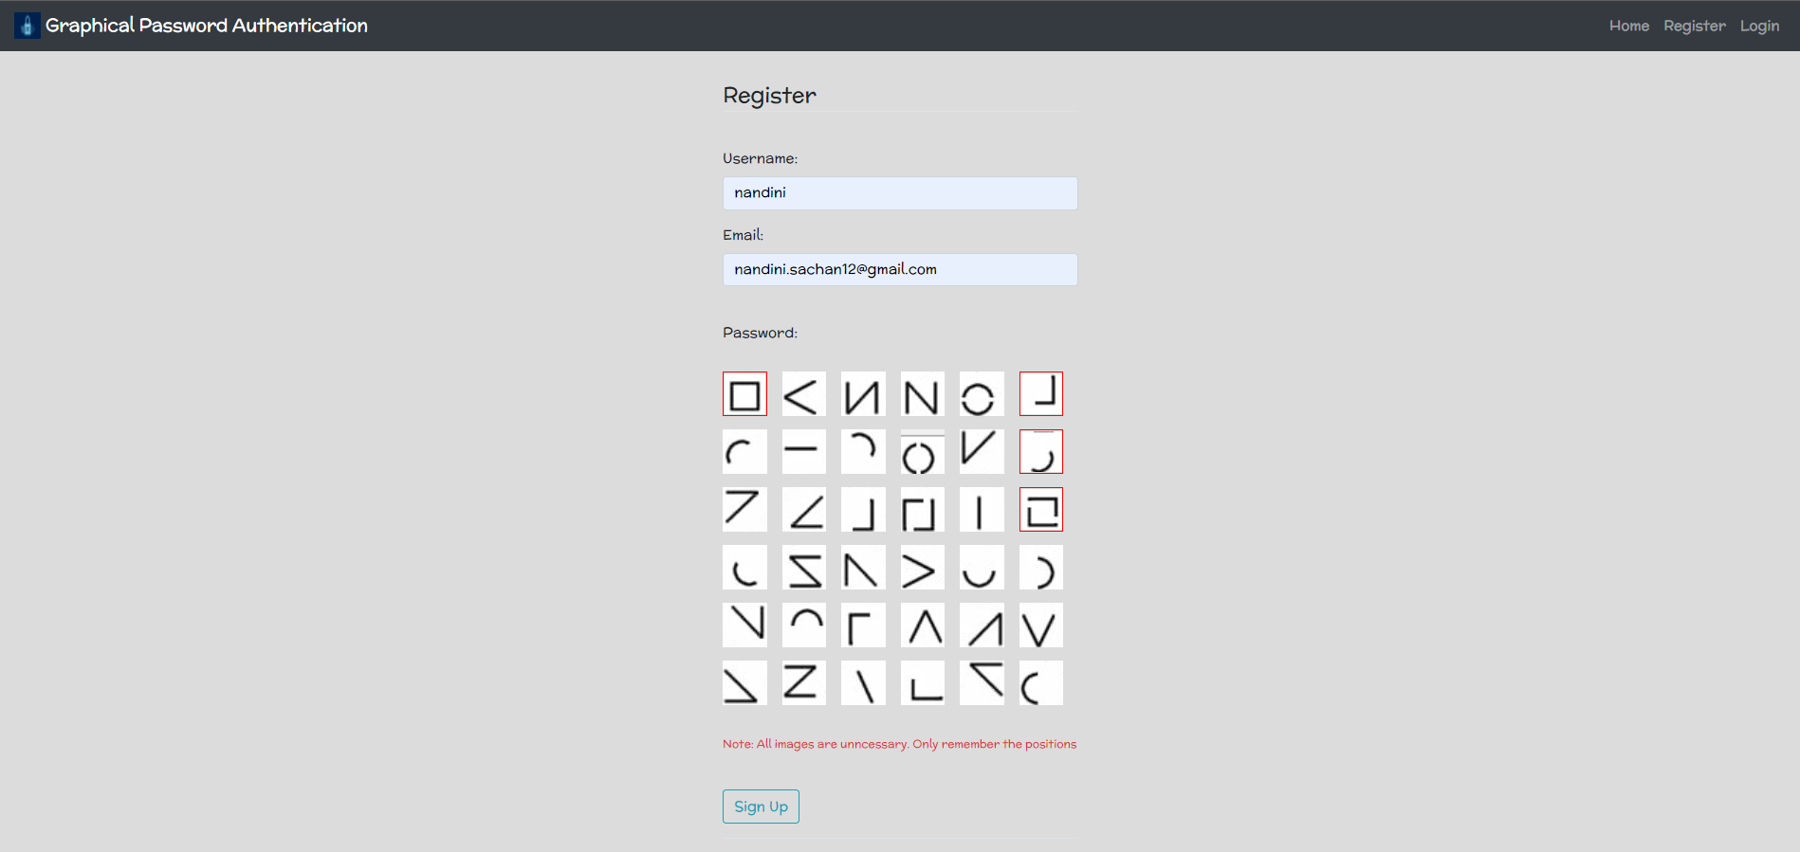
SIMULATION SNAPSHOTS
Shows registration process

Slide 25
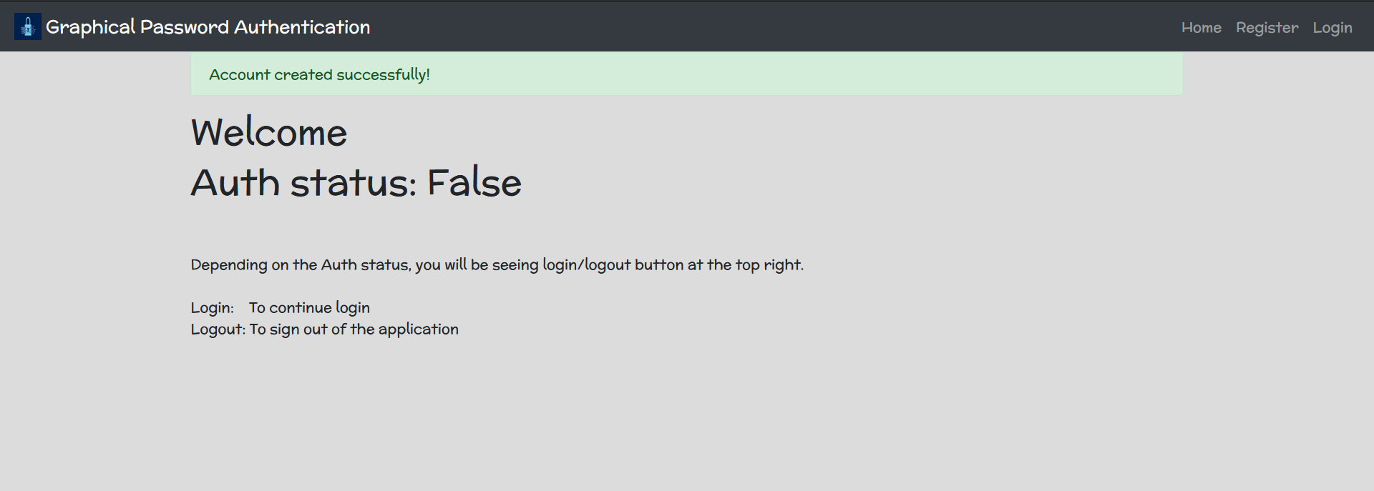
SIMULATION SNAPSHOTS
Shows account created successfully

Slide 26
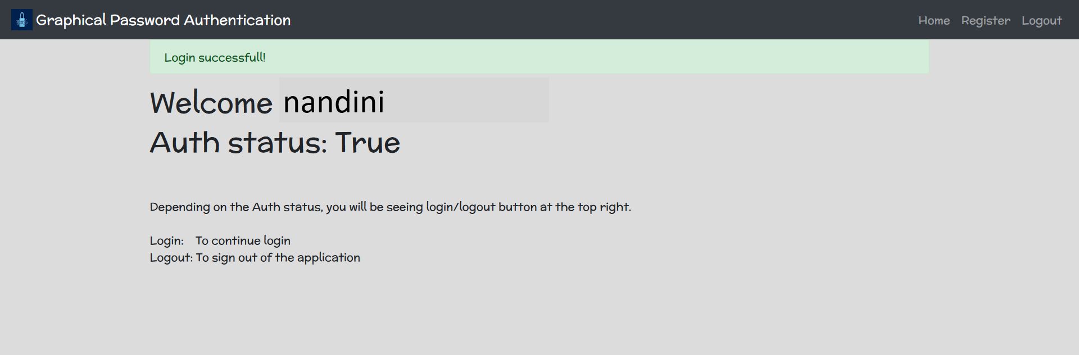
SIMULATION SNAPSHOTS
Shows login successful

Slide 27
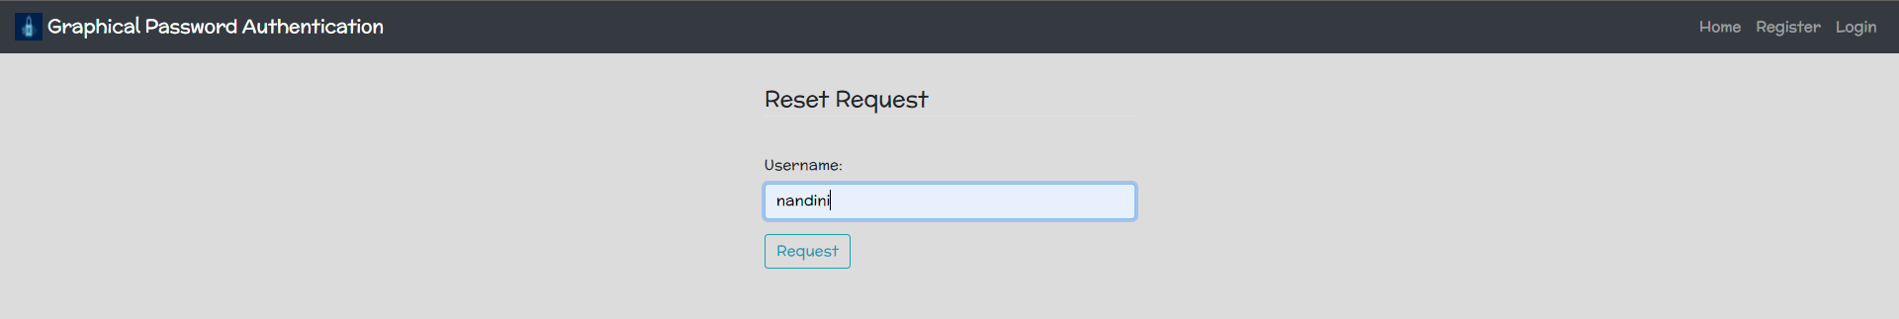
SIMULATION SNAPSHOTS
Shows request for resetting the password by username

Slide 28
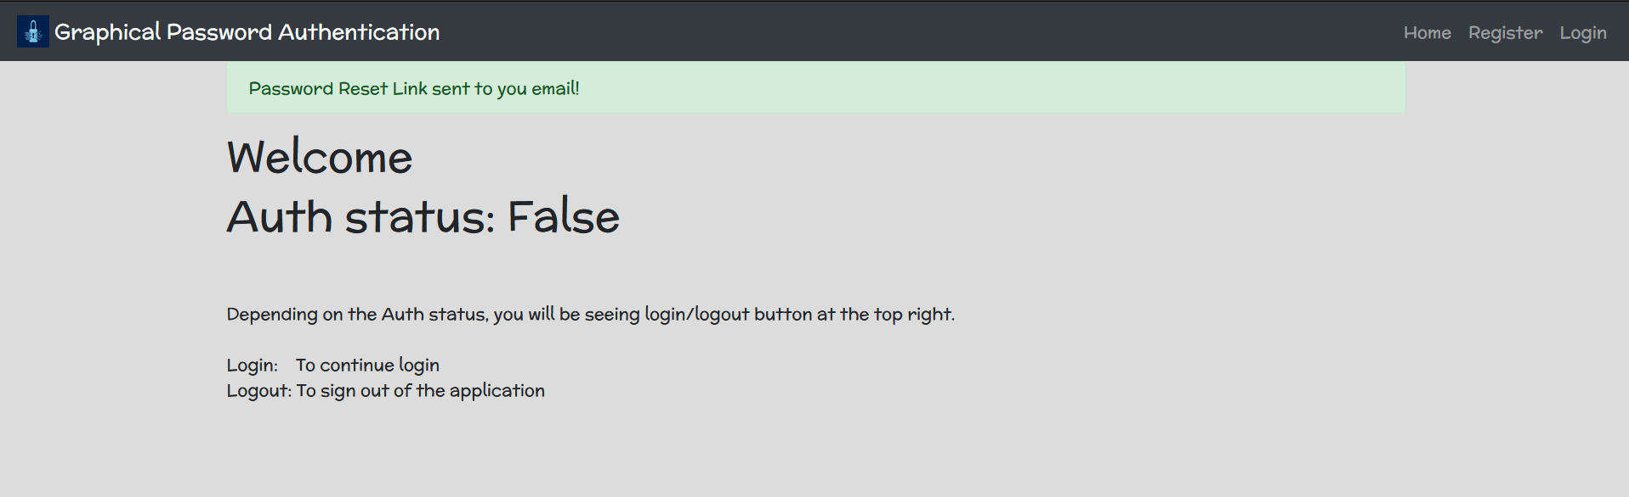
SIMULATION SNAPSHOTS
Shows password reset link is sent successfully

Slide 29
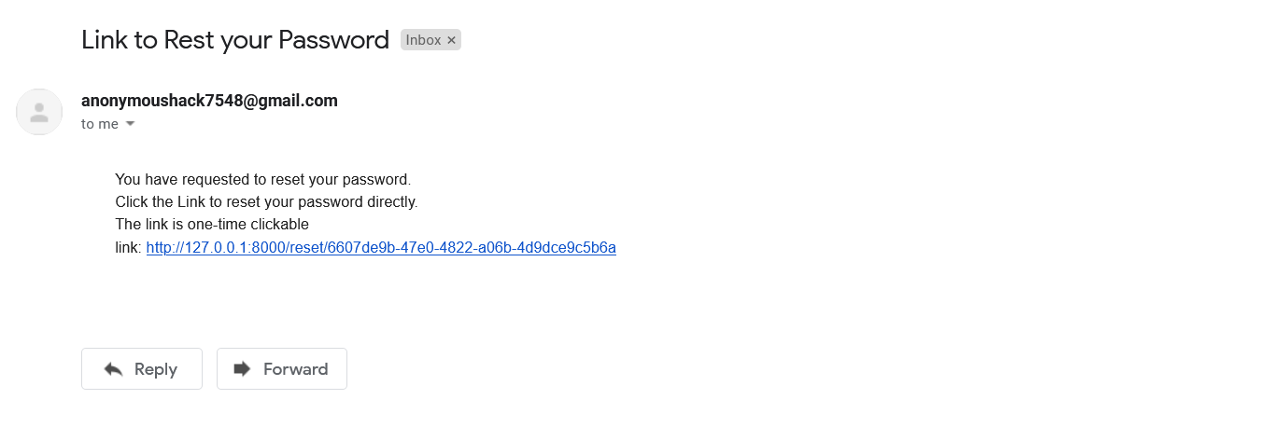
SIMULATION SNAPSHOTS
Shows email with the link for password reset

Slide 30
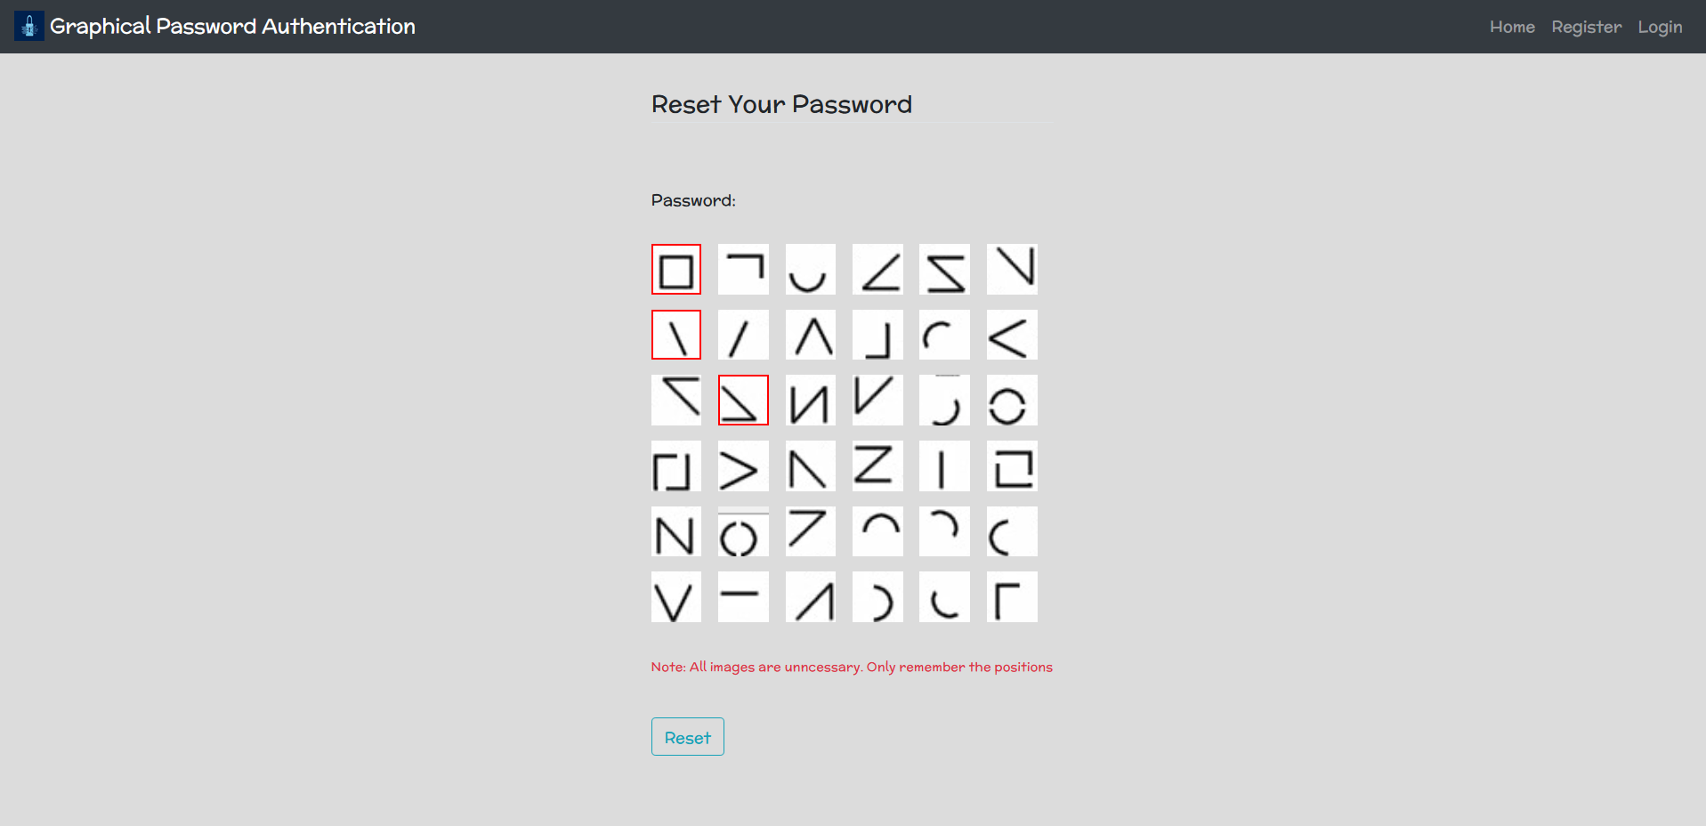
SIMULATION SNAPSHOTS
Shows process for password reset

Slide 31
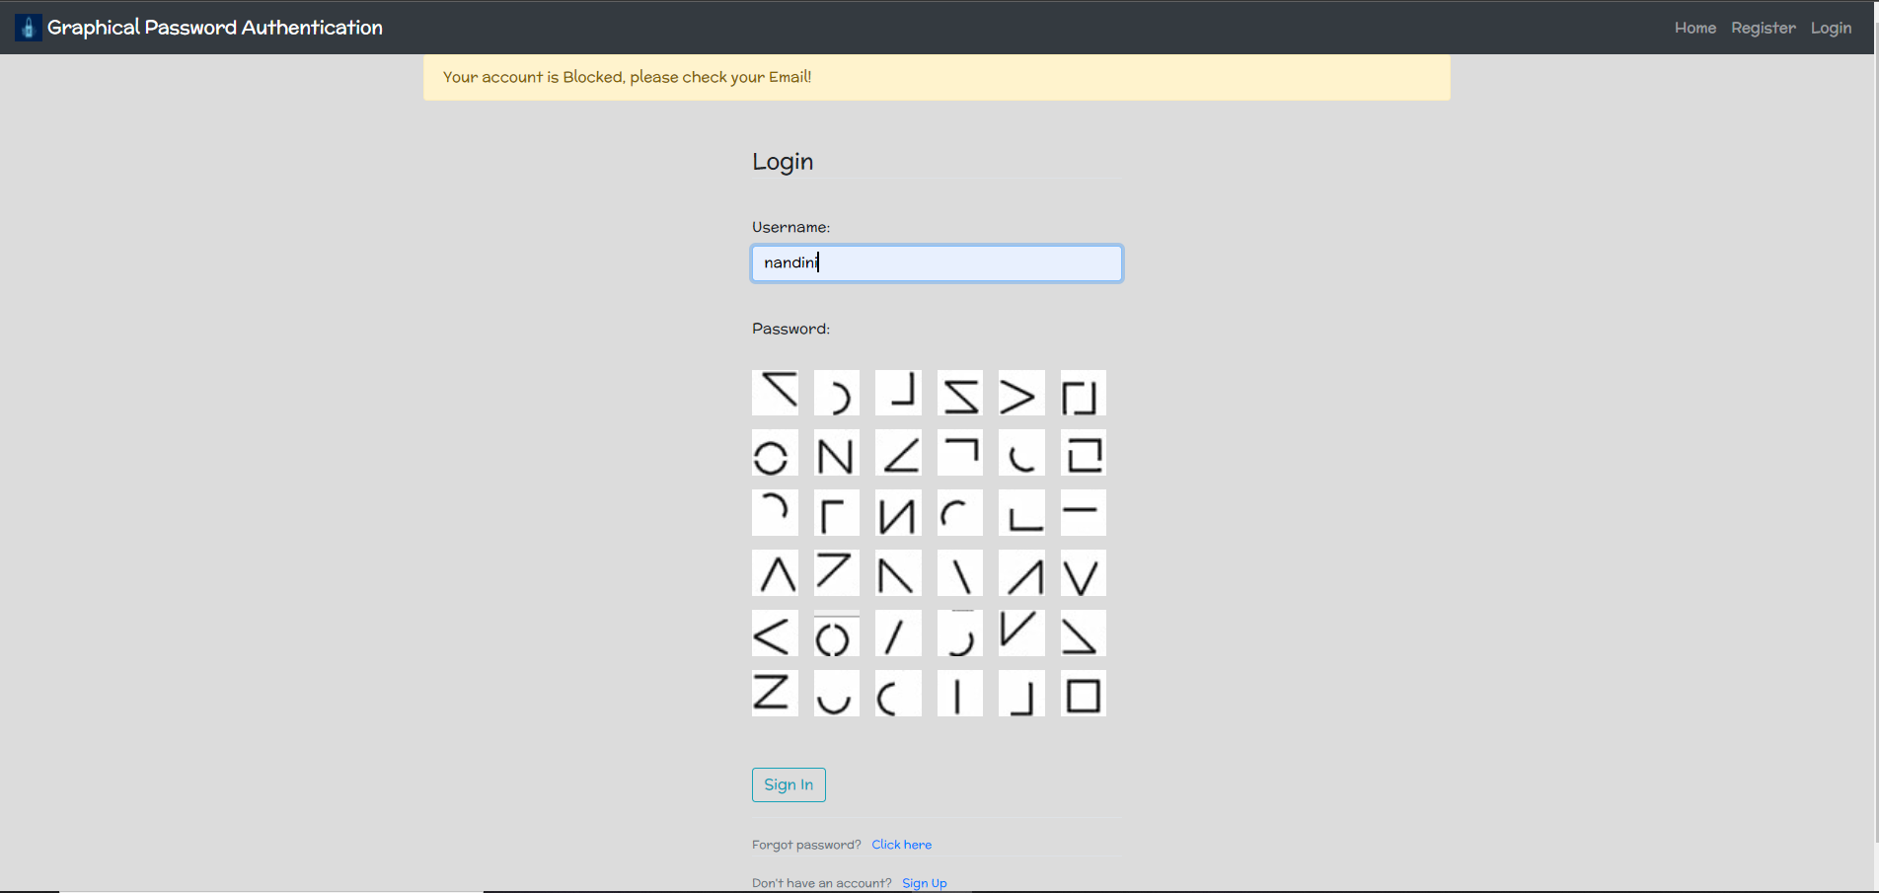
SIMULATION SNAPSHOTS
Shows account blocked due to too many failed login attempts

Slide 32
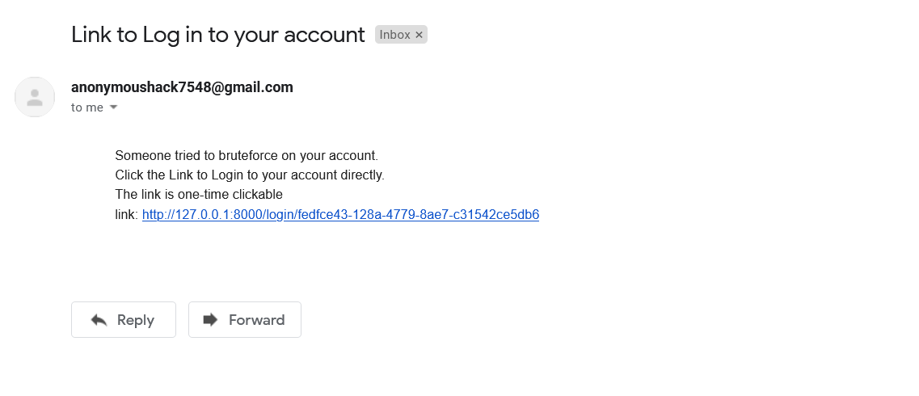
SIMULATION SNAPSHOTS
Shows warning email with login link sent due to brute force

Slide 33
PROPOSED GRAPHICAL AUTHENTICATION SYSTEM - ADVANTAGES
The system is user-friendly and has an easy interface.
It provides strong security against bot attacks or hackers.
Protects systems exposed to attacks.
Graphical passwords systems provide a way of making more human-friendly passwords.
In this system, the security of the system is very high.
Dictionary advances and brute power searches are infeasible.
Account will be blocked due to multiple failed attempts.

Slide 34
CONCLUSION
We are trying to make our authentication system more user friendly. We have considered both methods: text based and graphical based systems and trying to reduce the efforts required by end-user to remember passwords. A look at the advancement in technology over the past few years tells us that the next era will have system security at its core. Thus Graphical Password may be adapted in future as a major authentication system.
Account will be blocked due to multiple failed attempts.

Slide 35
REFERENCES
[1] Arti Bhanushali, Bhavika Mange, Harshika Vyas, Hetal Bhanushali and Poonam Bhogle, " Comparison of Graphical Password Authentication Techniques," International Journal of Computer Applications (0975 – 8887) Volume 116 – No. 1, April 2015.
[2] Harsh Kumar Sarohi, Farhat Ullah Khan, "Graphical Password Authentication Schemes: Current
Status and Key Issues," IJCSI International Journal of Computer Science Issues, Vol. 10, Issue 2, No 1, March 2013 ISSN (Print): 1694-0814 | ISSN (Online): 1694-0784 www.IJCSI.org.
[3] Mr. Jadhav Rajesh S, Mr. Chandole Durgesh K, Mr. Wani Milind D, Mr. Kusalkar Santosh R, Mr. Shinde Kiran G, Mr. Dighe Mohit S, " Graphical Password Authentication System," Volume III, Issue III, March 2014 IJLTEMAS ISSN 2278 - 2540.

Slide 36
REFERENCES
[4] Radhi Rafiee Afandi, Zalisham Jali, " ChoCD: Usable and Secure Graphical Password Authentication Scheme," Indian Journal of Science and Technology · January 2017
[5] M.ArunPrakash, T.R.Gokul, " Network Security-Overcome Password Hacking Through Graphical Password Authentication," Proceedings of the National Conference on Innovations in Emerging Technology-2011 Kongu Engineering College, Perundurai, Erode, Tamilnadu, India.17 & 18 February, 2011.pp.43-48..
[6]. Amol Bhand,vaibhav desale, Swati Shirke, Suvarna Pansambal (Shirke), " Enhancement of Password Authentication System Using Graphical Images," 2015 International Conference on Information Processing (ICIP) Vishwakarma Institute of Technology. Dec 16-19, 2015.

Slide 37
REFERENCES
[7] Radhika, Siddhartha Sankar Biswas, " COMPARATIVE STUDY OF GRAPHICAL USER AUTHENTICATION APPROACHES," A Monthly Journal of Computer Science and Information Technology ISSN 2320–088X IJCSMC, Vol. 3, Issue. 9, September 2014, pg.361 – 375.
[8] Gi-Chul Yang, " Development Status and Prospects of Graphical Password Authentication System in Korea," KSII TRANSACTIONS ON INTERNET AND INFORMATION SYSTEMS VOL. 13, NO. 11, Nov. 2019 5755 Copyright ⓒ 2019 KSII.
[9] Aditya Badhe, Dhananjay Dahake, Prajakta Rokade, " Graphical Authentication for Web Based Application," International Journal of advance research, ideas and innovations in technology ISSN: 2454-132X Impact factor: 4.295 (Volume 3, Issue 6) Available online at www.ijariit.com.
[10] ShraddhaM. Gurav, Leena S. Gawade, Prathamey K. Rane, Nilesh R. Khochare, " Graphical Password Authentication Cloud securing scheme," 2014 International Conference on Electronic Systems, Signal Processing and Computing Technologies.

